Slide 1
RTコンポーネント作成入門
宮本 信彦
国立研究開発法人産業技術総合研究所
インダストリアルCPS研究センター
ソフトウェアプラットフォーム研究チーム

Slide 2
資料(USBメモリで配布)
ppt
第2部、第3部のスライド
WEBページ(手順を記載したページ)
第2部(Windows)
第2部(Ubuntu)
第3部
Installer(OpenRTM-aist-1.2.1版 Windows用インストーラ)
OpenRTM-aistのインストールに問題があった場合に使用してください
script
この講習で使うシミュレータのインストールスクリプト(Ubuntu用)
EXE
EV3SimulatorComp.exe(シミュレータ)
sample
RobotController(本実習で作成するコンポーネントの見本)
ポータブル版LibreOffice
第3部で使用するポータブル版LibreOffice
2
Notes:
2

Slide 3
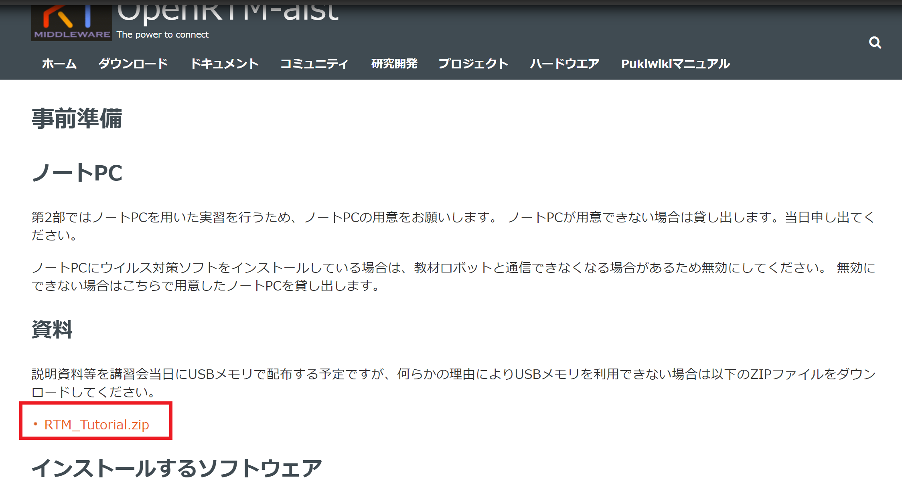
資料
USBメモリが挿せない場合は以下からダウンロード
https://openrtm.org/openrtm/ja/tutorial/irex2019
3
Notes:
3

Slide 4
インストールの確認(Windows)
OpenRTM-aist
OpenRTM-aist-1.2.1-RELEASE_x86_64.msi
インストール後に再起動する(2回再起動を必要とする環境もある)
Python
python-3.7.5-amd64.msi
OpenRTM-aistの64bit版をインストールする場合はPythonも64bit版をインストールする。
CMake
cmake-3.15.4-win64-x64.msi
Doxygen
doxygen-1.8.14-setup.exe
Visual Studio
Visual Studio 2019
4
Notes:
4

Slide 5
インストールの確認(Ubuntu)
OpenRTM-aist
$ wget https://raw.githubusercontent.com/OpenRTM/OpenRTM-aist/master/scripts/pkg_install_ubuntu.sh
$ sudo sh pkg_install_ubuntu.sh -l all --yes
CMake
$ sudo apt-get install cmake cmake-gui
Doxygen
$ sudo apt-get install doxygen
Java
$ sudo apt-get install openjdk-8-jdk
Code::Blocks(任意)
$ sudo apt-get install codeblocks
EV3SimulatorComp
sudo apt install git premake4 freeglut3-dev
$ wget https://raw.githubusercontent.com/OpenRTM/RTM_Tutorial_EV3/master/script/install_ev3_simulator.sh
sh install_ev3_simulator.sh
5
Notes:
5

Slide 6
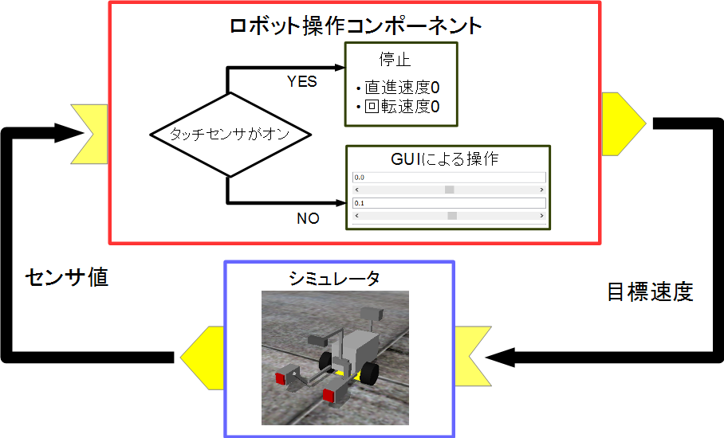
実習内容
シミュレータ上の車輪型移動ロボット(Educator Vehicle)の操作を行うコンポーネントの作成
GUIにより目標速度入力
タッチセンサがオンの時に停止
6
Notes:
6

Slide 7
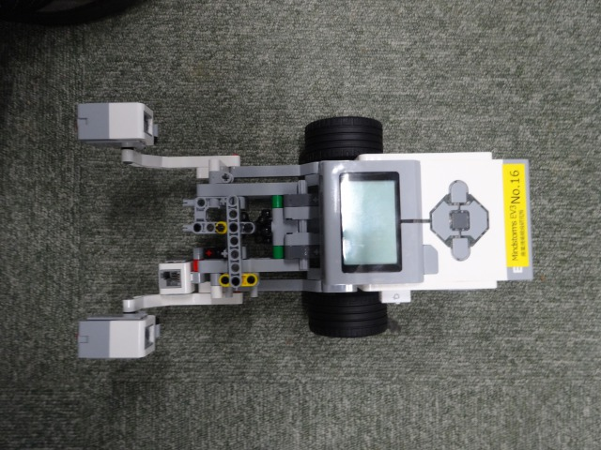
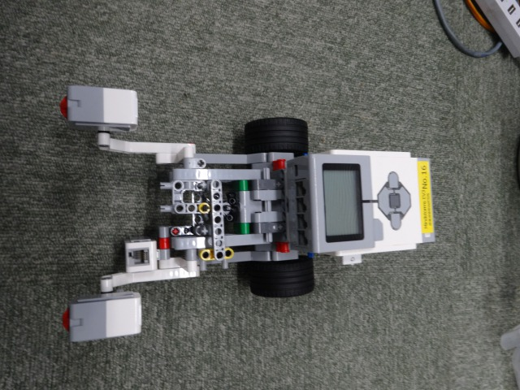
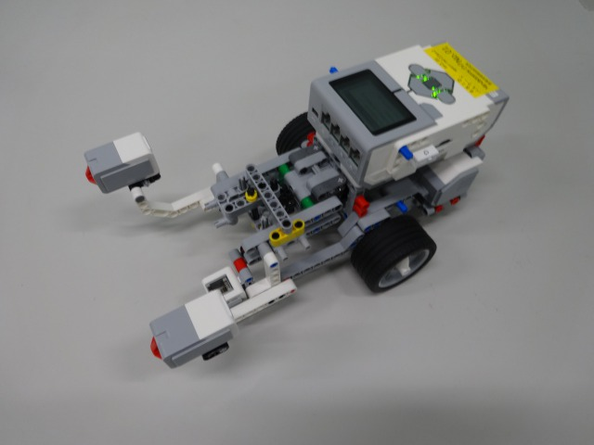
Educator Vehicle概要
LEGO Mindstorms EV3の組み立て例の一つ
EV3
駆動車輪
タッチセンサ
7
Notes:
7

Slide 8
全体の手順
RTC Builderによるソースコード等のひな型の作成
ソースコードの編集、ビルド
ビルドに必要な各種ファイルを生成
CMakeLists.txtの編集
CMakeにより各種ファイル生成
ソースコードの編集
RobotController.h、 RobotController.cppの編集
ビルド
Visual Studio、Code::Blocks
RTシステムエディタによるRTシステム作成、動作確認
RTシステム作成
データポート接続、コンフィギュレーションパラメータ設定
8
Notes:
8
At first, I’d like to mention about RT.
What is RT?
RT means Robot Technology.
This is not only standalone robots like this, but also robotic elements, sensors, actuators and so on.
We have studied on RT-Middleware.
RT-Middleware is software platform to integrate these RT-elements.

Slide 9
コンポーネント開発ツール
RTC Builderについて

Slide 10

RTC Builder
コンポーネントのプロファイル情報を入力し，ソースコード等のひな型を生成するツール
C++、Python、Javaのソースコードを出力
10
Notes:
10
At first, I’d like to mention about RT.
What is RT?
RT means Robot Technology.
This is not only standalone robots like this, but also robotic elements, sensors, actuators and so on.
We have studied on RT-Middleware.
RT-Middleware is software platform to integrate these RT-elements.

Slide 11

RTC Builderの起動
起動する手順
Windows(OpenRTM-aist 1.2)
デスクトップのショートカットをダブルクリック
デスクトップのショートカットがない場合
Windows 8.1
「スタート」→「アプリビュー(右下矢印)」→「OpenRTM-aist 1.2.1」→「OpenRTP」
※同じフォルダに「RTSystemEditorRCP」がありますが、これはRTC Builderが使えないので今回は「OpenRTP」を起動してください。
Windows 10
左下の「ここに入力して検索」にOpenRTPと入力して、表示されたOpenRTPを起動
Ubuntu
以下のコマンドを入力
$ openrtp
11
Notes:
11
At first, I’d like to mention about RT.
What is RT?
RT means Robot Technology.
This is not only standalone robots like this, but also robotic elements, sensors, actuators and so on.
We have studied on RT-Middleware.
RT-Middleware is software platform to integrate these RT-elements.

Slide 12
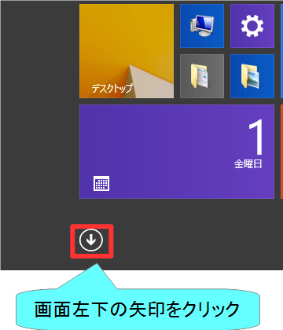
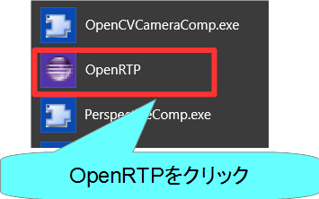
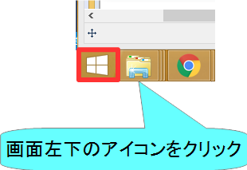
RTC Builderの起動
Windows 8.1
デスクトップ
スタート画面
アプリビュー
12
Notes:
12
At first, I’d like to mention about RT.
What is RT?
RT means Robot Technology.
This is not only standalone robots like this, but also robotic elements, sensors, actuators and so on.
We have studied on RT-Middleware.
RT-Middleware is software platform to integrate these RT-elements.

Slide 13
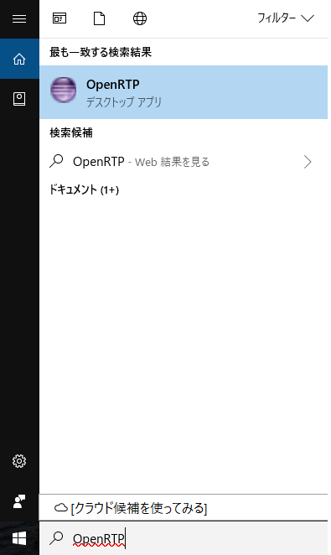
RTC Builderの起動
Windows 10
左下の「ここに入力して検索」に「OpenRTP」と入力
13
Notes:
13
At first, I’d like to mention about RT.
What is RT?
RT means Robot Technology.
This is not only standalone robots like this, but also robotic elements, sensors, actuators and so on.
We have studied on RT-Middleware.
RT-Middleware is software platform to integrate these RT-elements.

Slide 14
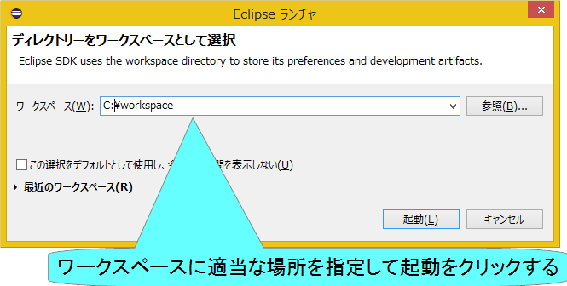
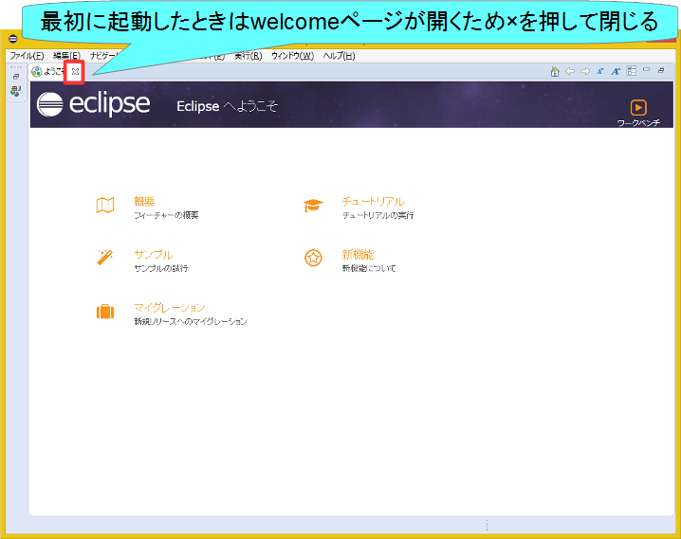
RTC Builderの起動
14
Notes:
14
At first, I’d like to mention about RT.
What is RT?
RT means Robot Technology.
This is not only standalone robots like this, but also robotic elements, sensors, actuators and so on.
We have studied on RT-Middleware.
RT-Middleware is software platform to integrate these RT-elements.

Slide 15
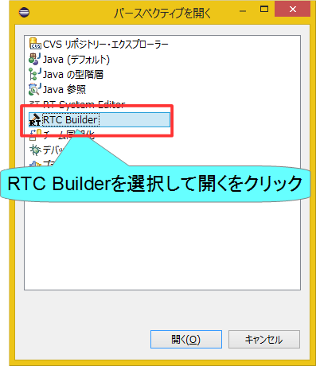

RTC Builderの起動
15
Notes:
15
At first, I’d like to mention about RT.
What is RT?
RT means Robot Technology.
This is not only standalone robots like this, but also robotic elements, sensors, actuators and so on.
We have studied on RT-Middleware.
RT-Middleware is software platform to integrate these RT-elements.

Slide 16
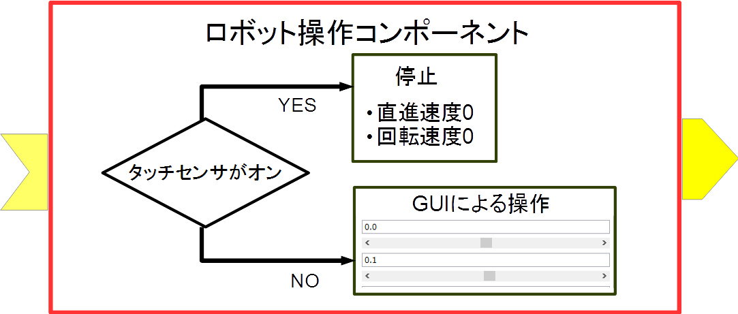
プロジェクト作成
RobotControllerコンポーネントのスケルトンコードを作成する。
車輪型移動ロボット操作コンポーネント
GUIでロボットを操作
タッチセンサがオンの場合に停止
16
Notes:
16
At first, I’d like to mention about RT.
What is RT?
RT means Robot Technology.
This is not only standalone robots like this, but also robotic elements, sensors, actuators and so on.
We have studied on RT-Middleware.
RT-Middleware is software platform to integrate these RT-elements.

Slide 17
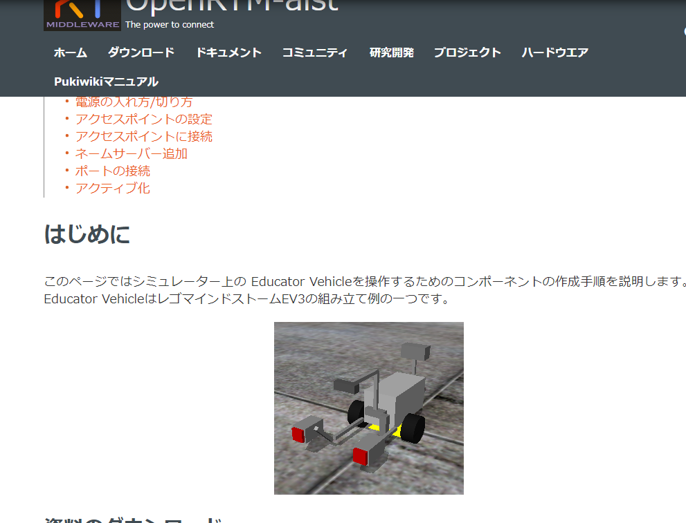
資料
Windowsの場合
配布資料の「WEBpage」フォルダ内の以下のHTMLファイル
チュートリアル(RTコンポーネントの作成入門、EV3、Windows) _ OpenRTM-aist.html
または、https://openrtm.org/openrtm/ja/node/6381
Ubuntuの場合
配布資料の「WEBpage」フォルダ内の以下のHTMLファイル
チュートリアル(RTコンポーネントの作成入門、EV3、Ubuntu) _ OpenRTM-aist.html
または、https://openrtm.org/openrtm/ja/node/6382
17
Notes:
17
At first, I’d like to mention about RT.
What is RT?
RT means Robot Technology.
This is not only standalone robots like this, but also robotic elements, sensors, actuators and so on.
We have studied on RT-Middleware.
RT-Middleware is software platform to integrate these RT-elements.

Slide 18
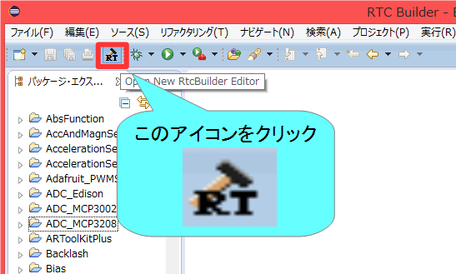
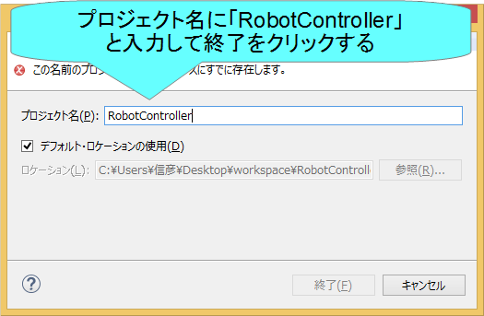
プロジェクト作成
OpenRTP起動時にワークスペースに指定したディレクトリに「RobotController」というフォルダが作成される
この時点では「RTC.xml」と「.project」のみが生成されている
以下の項目が設定する
基本プロファイル
アクティビティ・プロファイル
データポート・プロファイル
サービスポート・プロファイル
コンフィギュレーション
ドキュメント
言語環境
RTC.xml
18
Notes:
18
At first, I’d like to mention about RT.
What is RT?
RT means Robot Technology.
This is not only standalone robots like this, but also robotic elements, sensors, actuators and so on.
We have studied on RT-Middleware.
RT-Middleware is software platform to integrate these RT-elements.

Slide 19
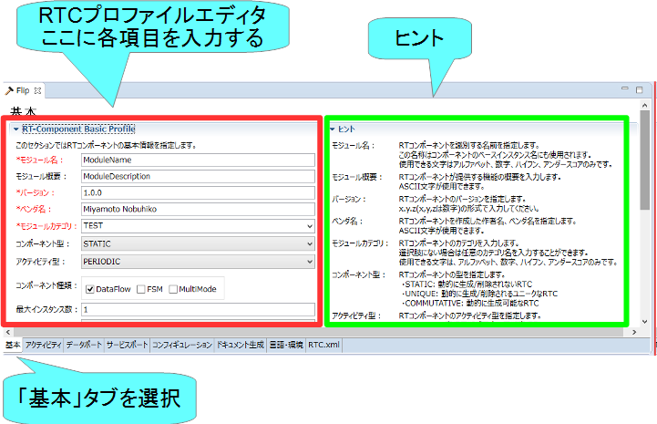
基本プロファイルの入力
RTコンポーネントのプロファイル情報など，コンポーネントの基本情報を設定．
コード生成，インポート/エクスポート，パッケージング処理を実行
19
Notes:
19
At first, I’d like to mention about RT.
What is RT?
RT means Robot Technology.
This is not only standalone robots like this, but also robotic elements, sensors, actuators and so on.
We have studied on RT-Middleware.
RT-Middleware is software platform to integrate these RT-elements.

Slide 20
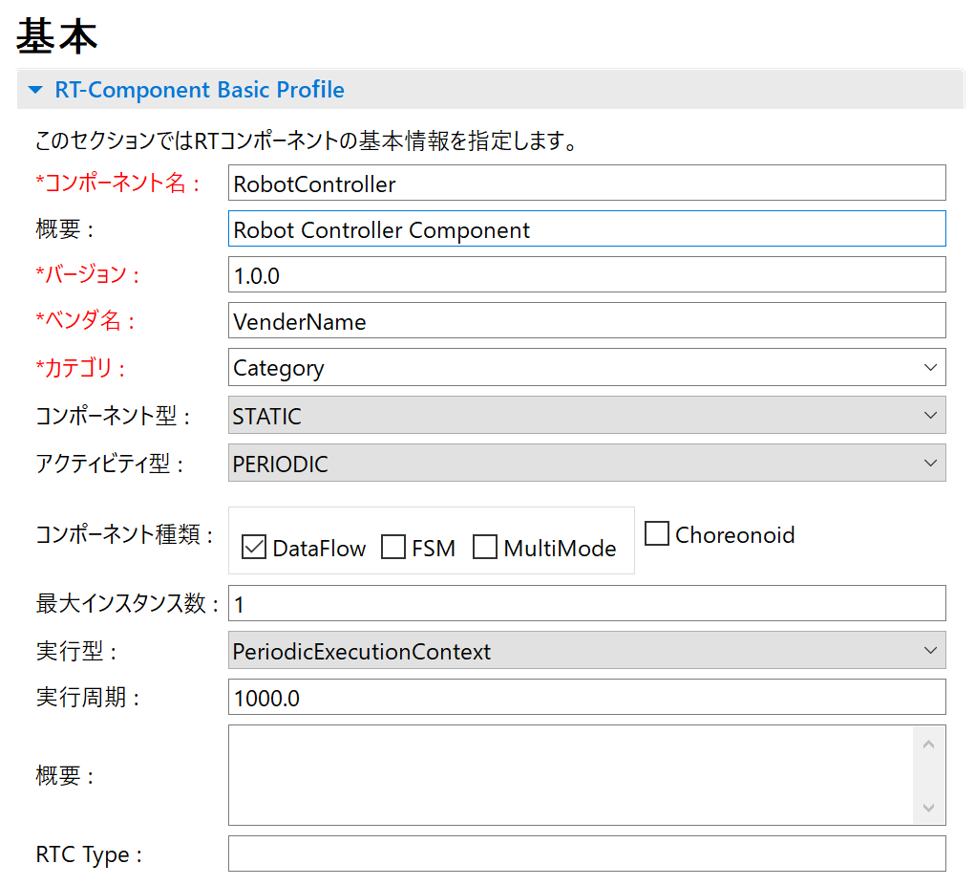
基本プロファイルの入力
コンポーネント名
RobotController
概要
任意(Robot Controller Component)
バージョン
任意(1.0.0)
ベンダ名
任意
カテゴリ
任意(Controller)
コンポーネント型
STATIC
アクティビティ型
PERIODIC
コンポーネントの種類
DataFlow
最大インスタンス数
1
実行型
PeriodicExecutionContext
実行周期
1000.0
概要
任意
20
Notes:
20
At first, I’d like to mention about RT.
What is RT?
RT means Robot Technology.
This is not only standalone robots like this, but also robotic elements, sensors, actuators and so on.
We have studied on RT-Middleware.
RT-Middleware is software platform to integrate these RT-elements.

Slide 21
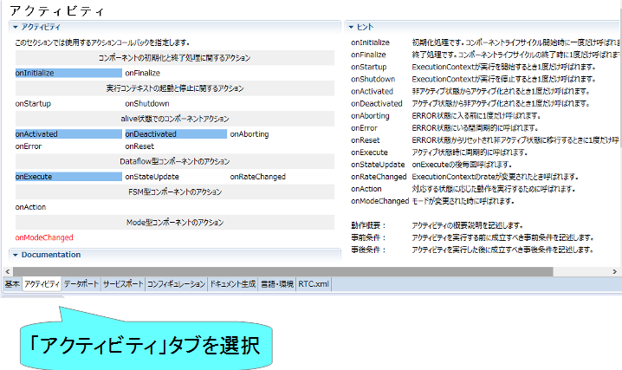
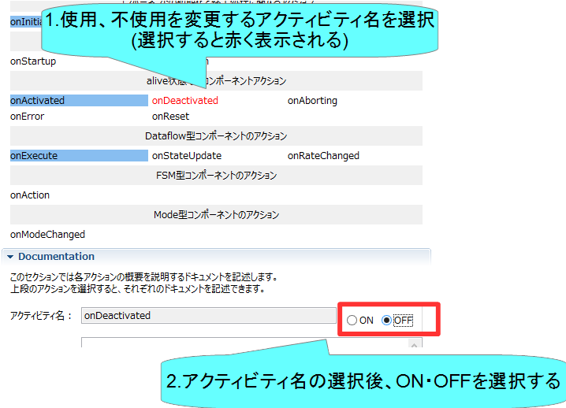
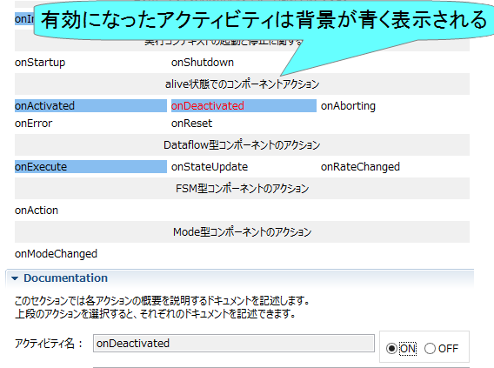
アクティビティの設定
使用するアクティビティを設定する
指定アクティビティを有効にする手順
Notes:
21
At first, I’d like to mention about RT.
What is RT?
RT means Robot Technology.
This is not only standalone robots like this, but also robotic elements, sensors, actuators and so on.
We have studied on RT-Middleware.
RT-Middleware is software platform to integrate these RT-elements.

Slide 22
アクティビティの設定
コールバック関数 | 処理
onInitialize | 初期化処理
onActivated | アクティブ化されるとき1度だけ呼ばれる
onExecute | アクティブ状態時に周期的に呼ばれる
onDeactivated | 非アクティブ化されるとき1度だけ呼ばれる
onAborting | ERROR状態に入る前に1度だけ呼ばれる
onReset | resetされる時に1度だけ呼ばれる
onError | ERROR状態のときに周期的に呼ばれる
onFinalize | 終了時に1度だけ呼ばれる
onStateUpdate | onExecuteの後毎回呼ばれる
onRateChanged | ExecutionContextのrateが変更されたとき1度だけ呼ばれる
onStartup | ExecutionContextが実行を開始するとき1度だけ呼ばれる
onShutdown | ExecutionContextが実行を停止するとき1度だけ呼ばれる
22
Notes:
22
At first, I’d like to mention about RT.
What is RT?
RT means Robot Technology.
This is not only standalone robots like this, but also robotic elements, sensors, actuators and so on.
We have studied on RT-Middleware.
RT-Middleware is software platform to integrate these RT-elements.

Slide 23

アクティビティの設定
以下のアクティビティを有効にする
onInitialize
onActivated
onDeactivated
onExecute
Documentationは適当に書いておいてください
空白でも大丈夫です
23
Notes:
23
At first, I’d like to mention about RT.
What is RT?
RT means Robot Technology.
This is not only standalone robots like this, but also robotic elements, sensors, actuators and so on.
We have studied on RT-Middleware.
RT-Middleware is software platform to integrate these RT-elements.

Slide 24
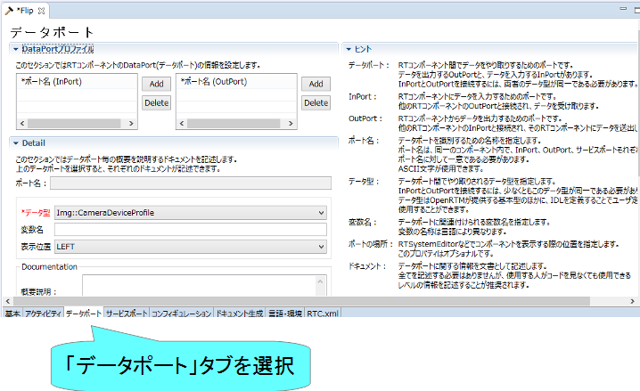
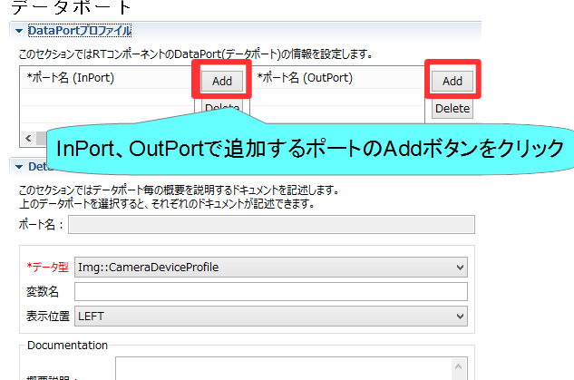
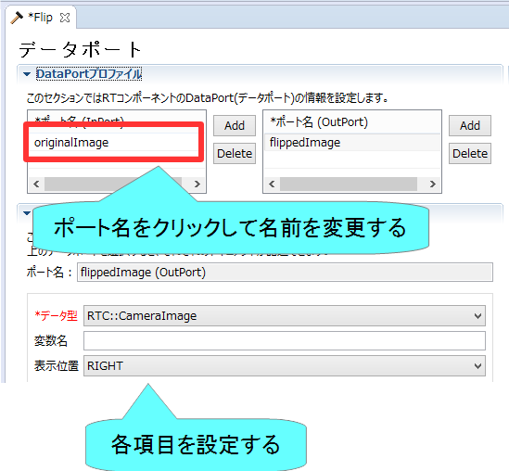
データポートの設定
InPort、OutPortの追加、設定を行う
データポートを追加する手順
Notes:
24
At first, I’d like to mention about RT.
What is RT?
RT means Robot Technology.
This is not only standalone robots like this, but also robotic elements, sensors, actuators and so on.
We have studied on RT-Middleware.
RT-Middleware is software platform to integrate these RT-elements.

Slide 25
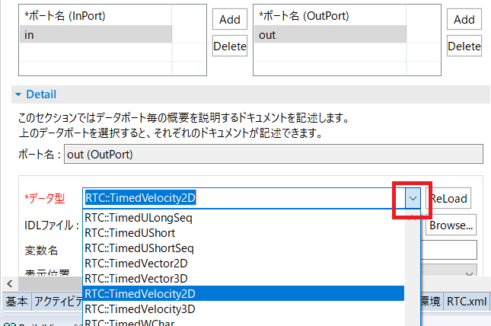
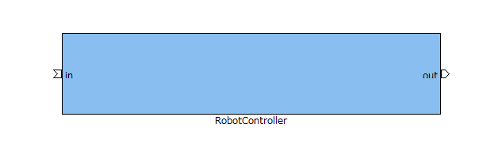
データポートの設定
以下のInPortを設定する
in
データ型： RTC::TimedBooleanSeq
他の項目は任意
※TimedBooleanと間違えないように注意してください。
以下のOutPortを設定する
out
データ型： RTC::TimedVelocity2D
他の項目は任意
※TimedVelocity3D型、TimedVector2D型と間違えないようにしてください
Notes:
25
At first, I’d like to mention about RT.
What is RT?
RT means Robot Technology.
This is not only standalone robots like this, but also robotic elements, sensors, actuators and so on.
We have studied on RT-Middleware.
RT-Middleware is software platform to integrate these RT-elements.

Slide 26


データポートについて
連続したデータを通信するためのポート
以下の例はデータフロー型がpush、サブスクリプション型がflush、インターフェース型がcorba_cdrの場合
Notes:
26
At first, I’d like to mention about RT.
What is RT?
RT means Robot Technology.
This is not only standalone robots like this, but also robotic elements, sensors, actuators and so on.
We have studied on RT-Middleware.
RT-Middleware is software platform to integrate these RT-elements.

Slide 27
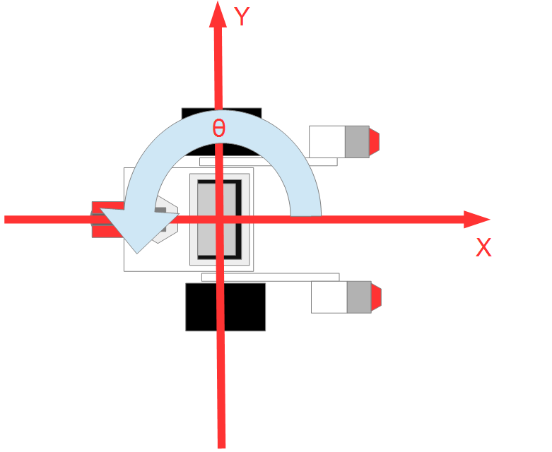

RTC::TimedVelocity2D型について
ExtendedDataTypes.idlで定義されている移動ロボットの速度を表現するためのデータ型
vx: X軸方向の速度
vy: Y軸方向の速度(車輪が横滑りしないと仮定すると0)
va: Z軸周りの角速度
vxで直進速度、vaで回転速度を設定
Notes:
27
At first, I’d like to mention about RT.
What is RT?
RT means Robot Technology.
This is not only standalone robots like this, but also robotic elements, sensors, actuators and so on.
We have studied on RT-Middleware.
RT-Middleware is software platform to integrate these RT-elements.

Slide 28
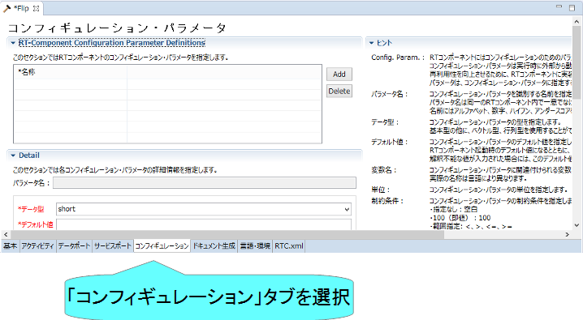
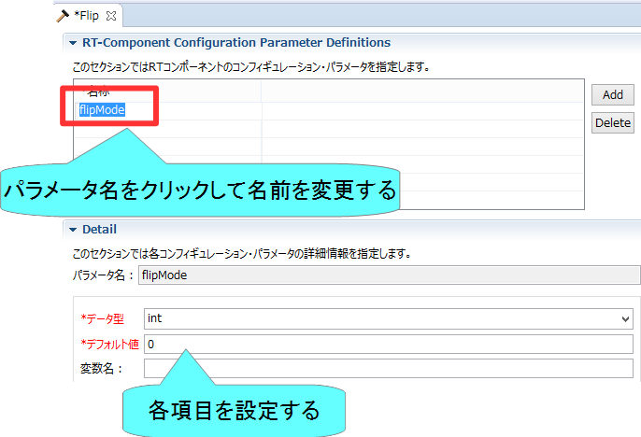
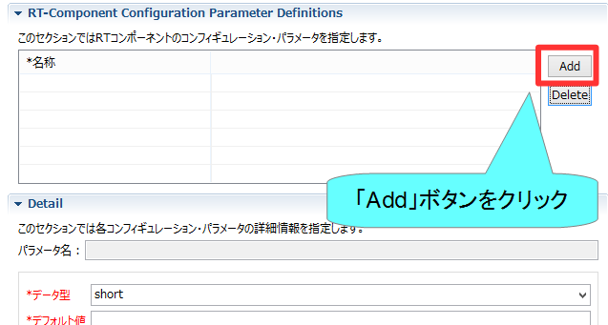
コンフィギュレーションの設定
コンフィギュレーションパラメータの追加、設定を行う
コンフィギュレーションパラメータを追加する手順
Notes:
28
At first, I’d like to mention about RT.
What is RT?
RT means Robot Technology.
This is not only standalone robots like this, but also robotic elements, sensors, actuators and so on.
We have studied on RT-Middleware.
RT-Middleware is software platform to integrate these RT-elements.

Slide 29
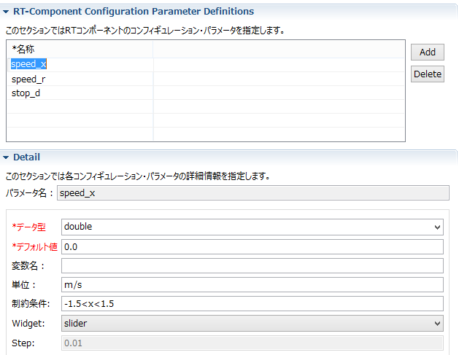

コンフィギュレーションの設定
以下のコンフィギュレーションパラメータを設定する
speed_x
データ型：double
デフォルト値： 0.0
制約条件：-1.5<x<1.5
Widget：slider
Step: 0.01
他の項目は任意
speed_r
データ型：double
デフォルト値： 0.0
制約条件：-2.0<x<2.0
Widget：slider
Step: 0.01
他の項目は任意
GUI(スライダー)による移動ロボットの操作ができるようにする
Notes:
29
At first, I’d like to mention about RT.
What is RT?
RT means Robot Technology.
This is not only standalone robots like this, but also robotic elements, sensors, actuators and so on.
We have studied on RT-Middleware.
RT-Middleware is software platform to integrate these RT-elements.

Slide 30

コンフィギュレーションパラメータの制約、Widgetの設定
RT System Editorでコンフィギュレーションパラメータを編集する際にGUIを表示する
Widget：text
制約条件：0<=x<=100
Widget：spin
Step：10
制約条件：0<=x<=100
Widget：slider
Step：10
Notes:
30
At first, I’d like to mention about RT.
What is RT?
RT means Robot Technology.
This is not only standalone robots like this, but also robotic elements, sensors, actuators and so on.
We have studied on RT-Middleware.
RT-Middleware is software platform to integrate these RT-elements.

Slide 31



コンフィギュレーションパラメータの制約、Widgetの設定
制約条件：(0,1,2,3)
Widget：radio
制約条件：(0,1,2,3)
Widget：checkbox
制約条件：(0,1,2,3)
Widget：ordered_list
Notes:
31
At first, I’d like to mention about RT.
What is RT?
RT means Robot Technology.
This is not only standalone robots like this, but also robotic elements, sensors, actuators and so on.
We have studied on RT-Middleware.
RT-Middleware is software platform to integrate these RT-elements.

Slide 32
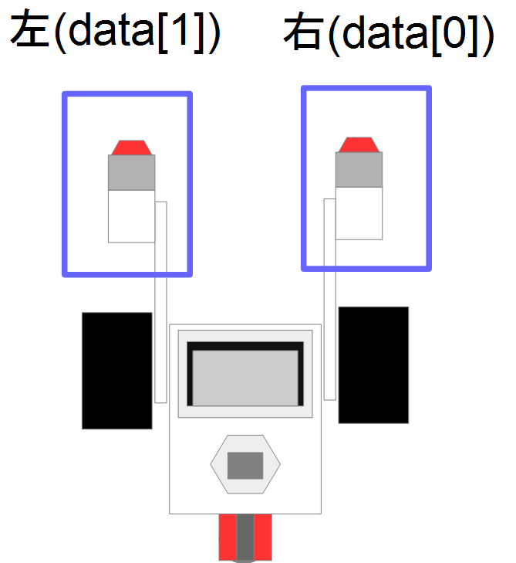
EV3のタッチセンサ
前部の左右にタッチセンサを搭載
TimedBooleanSeq型(bool型の配列)のデータ型で入力
配列の0番目が右側、1番目が左側に対応
Notes:
32
At first, I’d like to mention about RT.
What is RT?
RT means Robot Technology.
This is not only standalone robots like this, but also robotic elements, sensors, actuators and so on.
We have studied on RT-Middleware.
RT-Middleware is software platform to integrate these RT-elements.

Slide 33
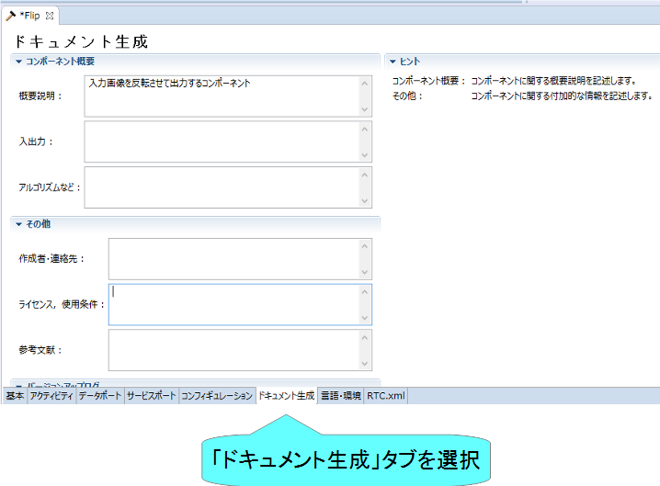
ドキュメントの設定
各種ドキュメント情報を設定
今回は適当に設定しておいてください。
空白でも大丈夫です
Notes:
33
At first, I’d like to mention about RT.
What is RT?
RT means Robot Technology.
This is not only standalone robots like this, but also robotic elements, sensors, actuators and so on.
We have studied on RT-Middleware.
RT-Middleware is software platform to integrate these RT-elements.

Slide 34
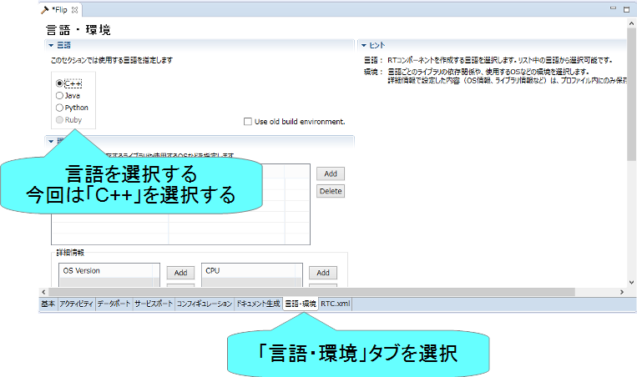
言語の設定
実装する言語，動作環境に関する情報を設定
Notes:
34
At first, I’d like to mention about RT.
What is RT?
RT means Robot Technology.
This is not only standalone robots like this, but also robotic elements, sensors, actuators and so on.
We have studied on RT-Middleware.
RT-Middleware is software platform to integrate these RT-elements.

Slide 35
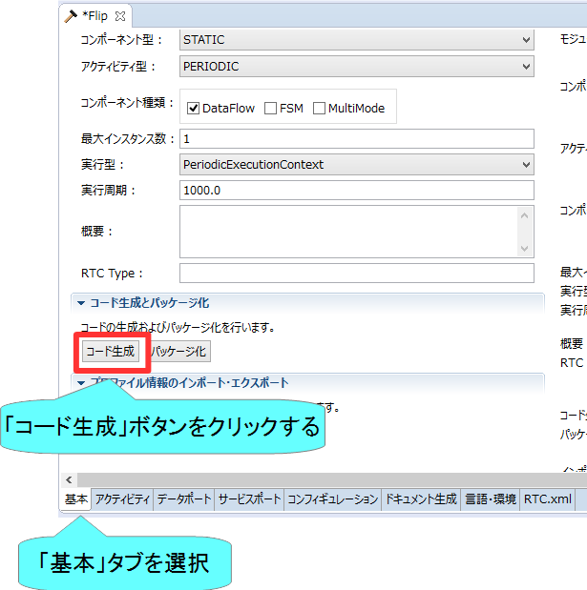
スケルトンコードの生成
基本タブからコード生成ボタンを押すことでスケルトンコードが生成される
Workspace\RobotController以下に生成
ソースコード
C++ソースファイル(.cpp)
ヘッダーファイル(.h)
このソースコードにロボットを操作する処理を記述する
CMakeの設定ファイル
CMakeLists.txt
rtc.conf、RobotController.conf
以下略
ファイルが生成できているかを確認してください
Notes:
35
At first, I’d like to mention about RT.
What is RT?
RT means Robot Technology.
This is not only standalone robots like this, but also robotic elements, sensors, actuators and so on.
We have studied on RT-Middleware.
RT-Middleware is software platform to integrate these RT-elements.

Slide 36
ソースコードの編集、RTCのビルド

Slide 37
手順
ビルドに必要な各種ファイルを生成
CMakeLists.txtの編集
CMakeにより各種ファイル生成
ソースコードの編集
RobotController.hの編集
RobotController.cppの編集
ビルド
Windows： Visual Studio
Ubuntu： Code::Blocks
37
Notes:
37
At first, I’d like to mention about RT.
What is RT?
RT means Robot Technology.
This is not only standalone robots like this, but also robotic elements, sensors, actuators and so on.
We have studied on RT-Middleware.
RT-Middleware is software platform to integrate these RT-elements.

Slide 38
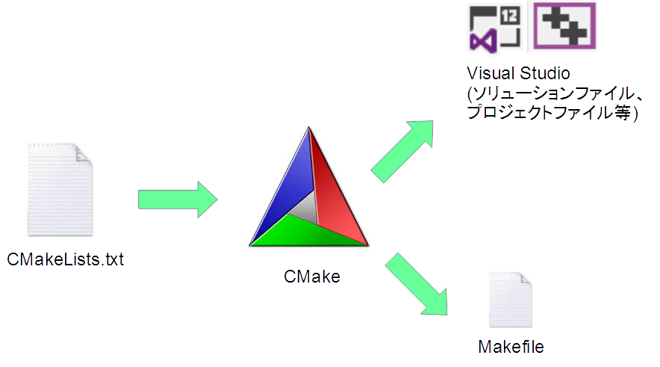
CMake
ビルドに必要な各種ファイルを生成
CMakeLists.txtに設定を記述
RTC Builderでスケルトンコードを作成した時にCMakeLists.txtも生成されている
38
Notes:
38
At first, I’d like to mention about RT.
What is RT?
RT means Robot Technology.
This is not only standalone robots like this, but also robotic elements, sensors, actuators and so on.
We have studied on RT-Middleware.
RT-Middleware is software platform to integrate these RT-elements.

Slide 39
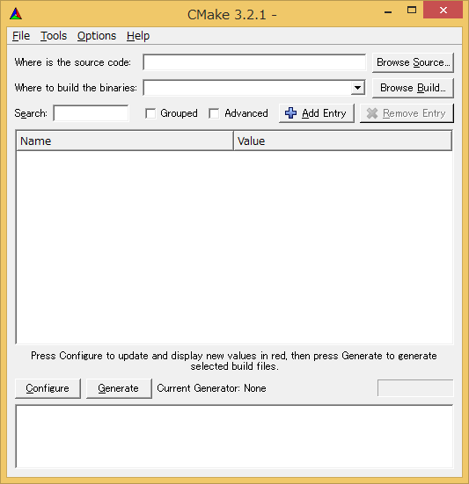
ビルドに必要なファイルの生成
CMakeを使用する
Windows 8.1
「スタート」→「アプリビュー(右下矢印)」→「CMake」→「CMake (cmake-gui)」
Windows 10
左下の「ここに入力して検索」にCMakeと入力して表示されたCMake(cmake-gui)を起動
Ubuntu
コマンドで「cmake-gui」を入力
39
Notes:
39
At first, I’d like to mention about RT.
What is RT?
RT means Robot Technology.
This is not only standalone robots like this, but also robotic elements, sensors, actuators and so on.
We have studied on RT-Middleware.
RT-Middleware is software platform to integrate these RT-elements.

Slide 40
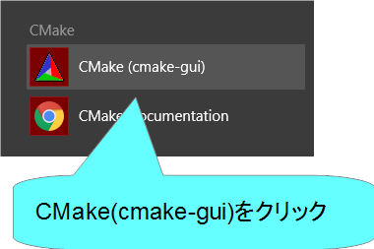
cmake-guiの起動
Windows 8.1
デスクトップ
スタート画面
アプリビュー
40
Notes:
40
At first, I’d like to mention about RT.
What is RT?
RT means Robot Technology.
This is not only standalone robots like this, but also robotic elements, sensors, actuators and so on.
We have studied on RT-Middleware.
RT-Middleware is software platform to integrate these RT-elements.

Slide 41
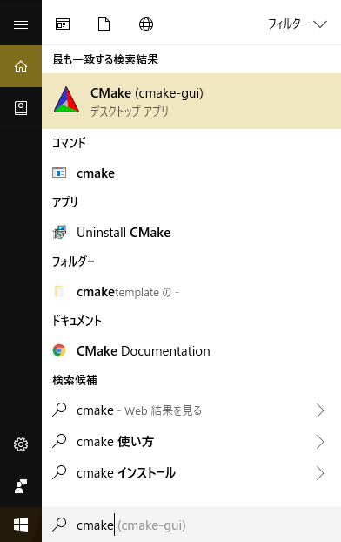
cmake-guiの起動
Windows 10
左下の「ここに入力して検索」に「cmake」と入力
41
Notes:
41
At first, I’d like to mention about RT.
What is RT?
RT means Robot Technology.
This is not only standalone robots like this, but also robotic elements, sensors, actuators and so on.
We have studied on RT-Middleware.
RT-Middleware is software platform to integrate these RT-elements.

Slide 42
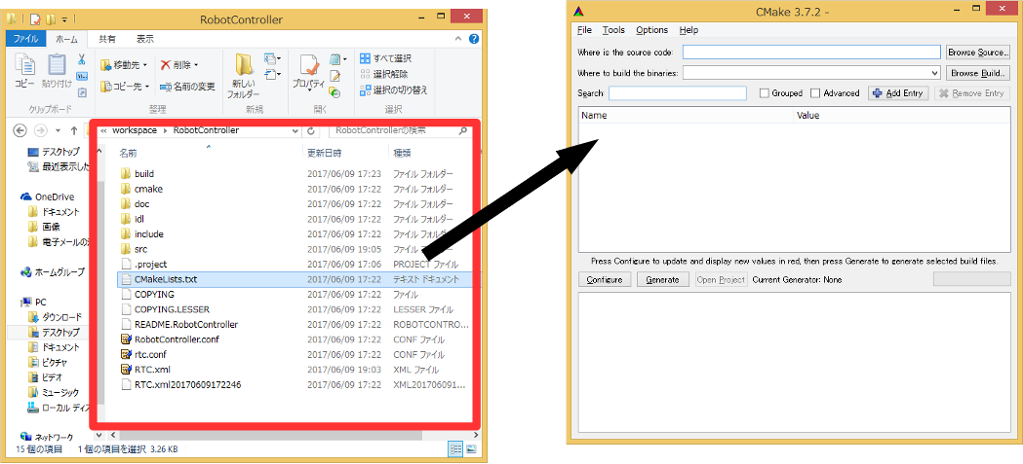
ビルドに必要なファイルの生成
CMakeLists.txtをcmake-guiにドラックアンドドロップ
CMakeLists.txtはRTC Builderで生成したプロジェクトのフォルダ
(例： C:\workspace\RobotController)
42
Notes:
42
At first, I’d like to mention about RT.
What is RT?
RT means Robot Technology.
This is not only standalone robots like this, but also robotic elements, sensors, actuators and so on.
We have studied on RT-Middleware.
RT-Middleware is software platform to integrate these RT-elements.

Slide 43
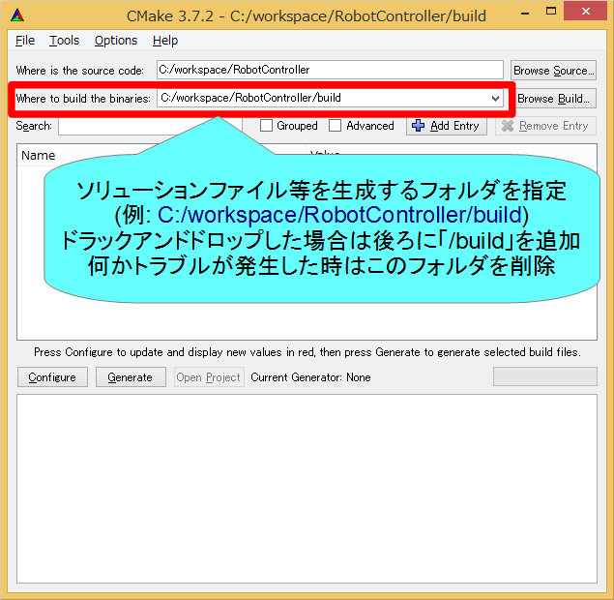
ビルドに必要なファイルの生成
43
Notes:
43
At first, I’d like to mention about RT.
What is RT?
RT means Robot Technology.
This is not only standalone robots like this, but also robotic elements, sensors, actuators and so on.
We have studied on RT-Middleware.
RT-Middleware is software platform to integrate these RT-elements.

Slide 44
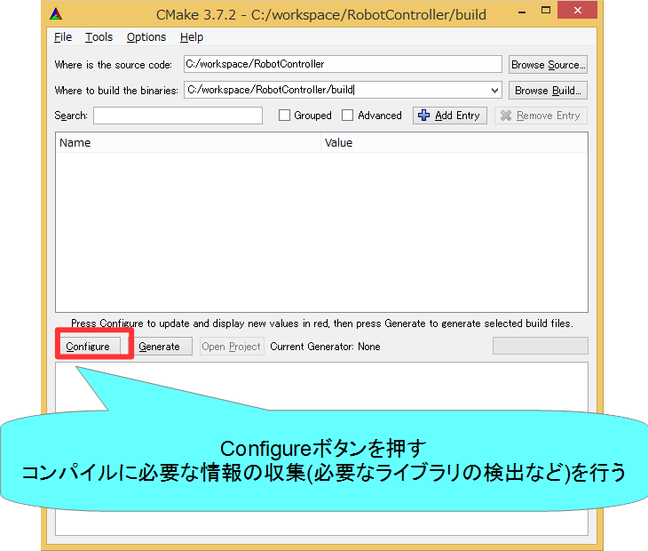
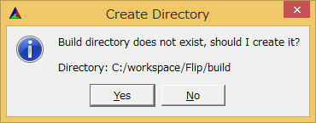
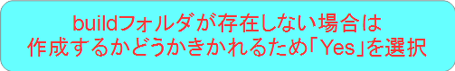
ビルドに必要なファイルの生成
44
Notes:
44
At first, I’d like to mention about RT.
What is RT?
RT means Robot Technology.
This is not only standalone robots like this, but also robotic elements, sensors, actuators and so on.
We have studied on RT-Middleware.
RT-Middleware is software platform to integrate these RT-elements.

Slide 45
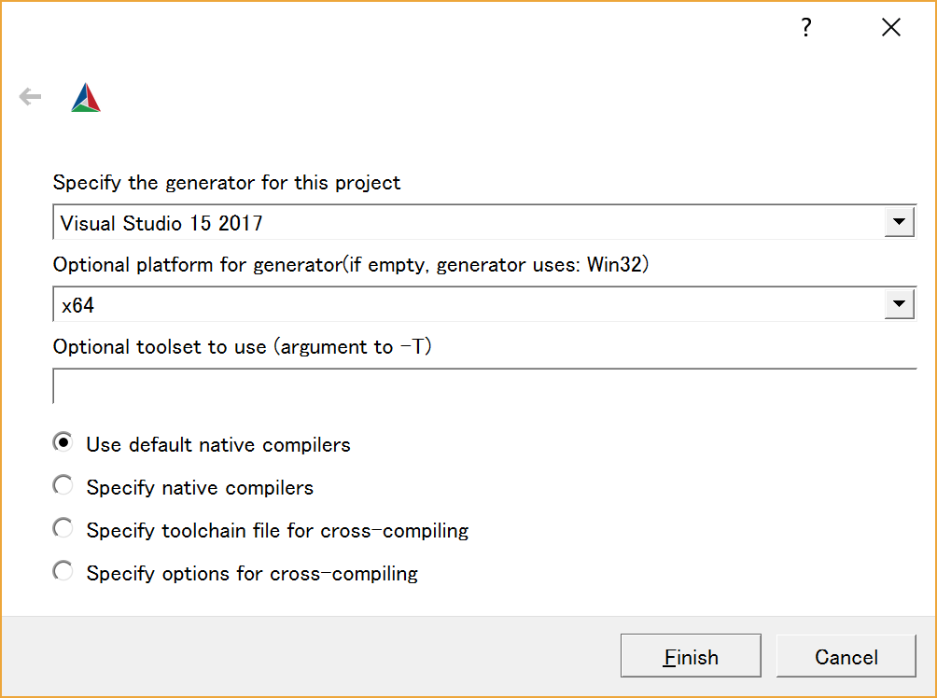
CMake 3.14以降の場合
ビルド環境の設定
Visual Studio 2019 → Visual Studio 16 2019
Visual Studio 2017 → Visual Studio 15 2017
Code::Blocks → CodeBlocks – Unix Makefiles
※貸し出したPCでは「Visual Studio 15 2017」を指定
X64を選択する。
設定後、Finishボタンを押す
45
Notes:
45
At first, I’d like to mention about RT.
What is RT?
RT means Robot Technology.
This is not only standalone robots like this, but also robotic elements, sensors, actuators and so on.
We have studied on RT-Middleware.
RT-Middleware is software platform to integrate these RT-elements.

Slide 46
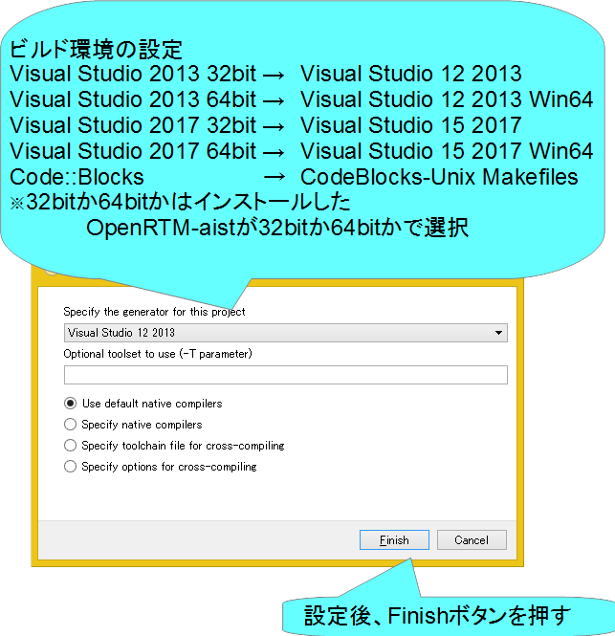
CMake 3.13以前の場合
46
Notes:
46
At first, I’d like to mention about RT.
What is RT?
RT means Robot Technology.
This is not only standalone robots like this, but also robotic elements, sensors, actuators and so on.
We have studied on RT-Middleware.
RT-Middleware is software platform to integrate these RT-elements.

Slide 47
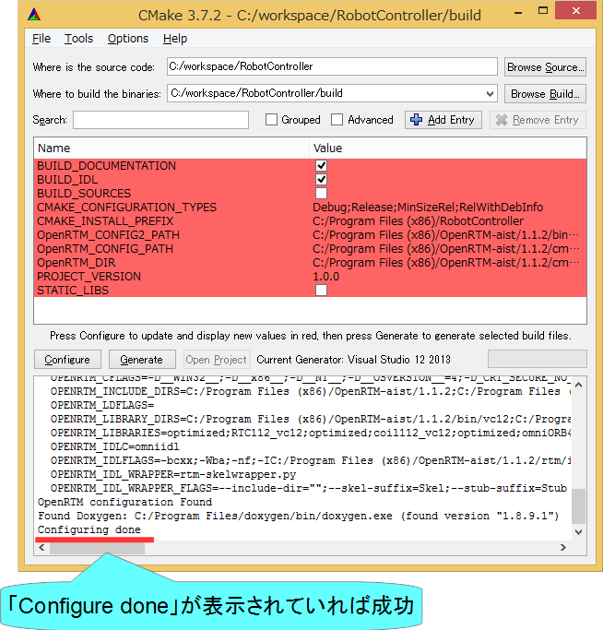
ビルドに必要なファイルの生成
47
Notes:
47
At first, I’d like to mention about RT.
What is RT?
RT means Robot Technology.
This is not only standalone robots like this, but also robotic elements, sensors, actuators and so on.
We have studied on RT-Middleware.
RT-Middleware is software platform to integrate these RT-elements.

Slide 48
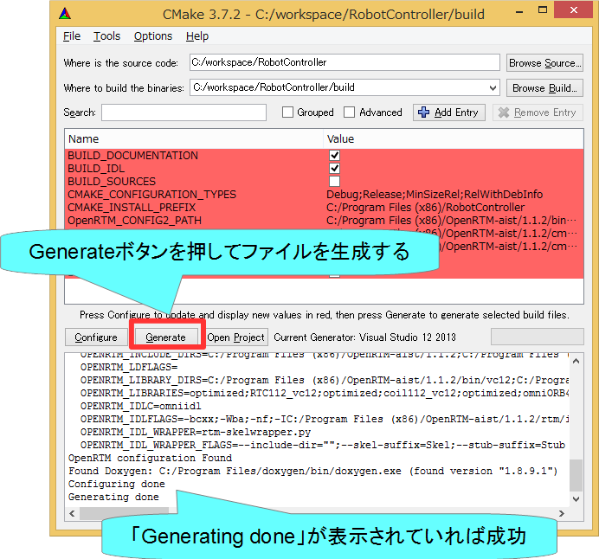
ビルドに必要なファイルの生成
48
Notes:
48
At first, I’d like to mention about RT.
What is RT?
RT means Robot Technology.
This is not only standalone robots like this, but also robotic elements, sensors, actuators and so on.
We have studied on RT-Middleware.
RT-Middleware is software platform to integrate these RT-elements.

Slide 49
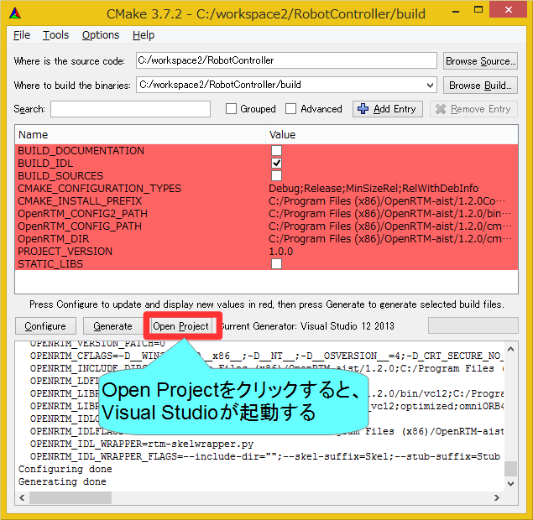
ソースコードの編集
49
Notes:
49
At first, I’d like to mention about RT.
What is RT?
RT means Robot Technology.
This is not only standalone robots like this, but also robotic elements, sensors, actuators and so on.
We have studied on RT-Middleware.
RT-Middleware is software platform to integrate these RT-elements.

Slide 50
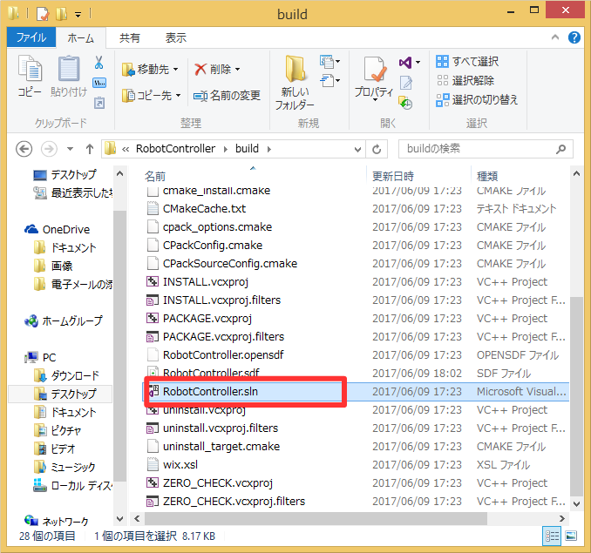

ソースコードの編集
CMake-guiのバージョンが古い場合は「Open Project」ボタンがないため、ファイルをダブルクリックして開く
Windows
buildフォルダの「RobotController.sln」をダブルクリックして開く
Ubuntu
buildフォルダの「RobotController.cbp」をダブルクリックして開く
50
Notes:
50
At first, I’d like to mention about RT.
What is RT?
RT means Robot Technology.
This is not only standalone robots like this, but also robotic elements, sensors, actuators and so on.
We have studied on RT-Middleware.
RT-Middleware is software platform to integrate these RT-elements.

Slide 51


ソースコードの編集
Windows
Visual Studioが起動
Ubuntu
Code::Blocksが起動
51
Notes:
51
At first, I’d like to mention about RT.
What is RT?
RT means Robot Technology.
This is not only standalone robots like this, but also robotic elements, sensors, actuators and so on.
We have studied on RT-Middleware.
RT-Middleware is software platform to integrate these RT-elements.

Slide 52


ソースコードの編集
RobotController.hの編集
Visual Studio
Code::Blocks
52
Notes:
52
At first, I’d like to mention about RT.
What is RT?
RT means Robot Technology.
This is not only standalone robots like this, but also robotic elements, sensors, actuators and so on.
We have studied on RT-Middleware.
RT-Middleware is software platform to integrate these RT-elements.

Slide 53

ソースコードの編集
RobotController.hの編集
53
Notes:
53
At first, I’d like to mention about RT.
What is RT?
RT means Robot Technology.
This is not only standalone robots like this, but also robotic elements, sensors, actuators and so on.
We have studied on RT-Middleware.
RT-Middleware is software platform to integrate these RT-elements.

Slide 54


ソースコードの編集
RobotController.cppの編集
詳細はUSBメモリの資料を参考にしてください
Visual Studio
Code::Blocks
54
Notes:
54
At first, I’d like to mention about RT.
What is RT?
RT means Robot Technology.
This is not only standalone robots like this, but also robotic elements, sensors, actuators and so on.
We have studied on RT-Middleware.
RT-Middleware is software platform to integrate these RT-elements.

Slide 55


ソースコードの編集
RobotController.cppの編集
55
Notes:
55
At first, I’d like to mention about RT.
What is RT?
RT means Robot Technology.
This is not only standalone robots like this, but also robotic elements, sensors, actuators and so on.
We have studied on RT-Middleware.
RT-Middleware is software platform to integrate these RT-elements.

Slide 56

ソースコードの編集
RobotController.cppの編集
56
Notes:
56
At first, I’d like to mention about RT.
What is RT?
RT means Robot Technology.
This is not only standalone robots like this, but also robotic elements, sensors, actuators and so on.
We have studied on RT-Middleware.
RT-Middleware is software platform to integrate these RT-elements.

Slide 57

ソースコードの編集
データを読み込む手順
57
Notes:
57
At first, I’d like to mention about RT.
What is RT?
RT means Robot Technology.
This is not only standalone robots like this, but also robotic elements, sensors, actuators and so on.
We have studied on RT-Middleware.
RT-Middleware is software platform to integrate these RT-elements.

Slide 58

ソースコードの編集
データを書き込む手順
58
Notes:
58
At first, I’d like to mention about RT.
What is RT?
RT means Robot Technology.
This is not only standalone robots like this, but also robotic elements, sensors, actuators and so on.
We have studied on RT-Middleware.
RT-Middleware is software platform to integrate these RT-elements.

Slide 59


ソースコードのコンパイル
Visual Studio
Code::Blocks
成功した場合、実行ファイルが生成される
Windows
build\srcフォルダのRelease(もしくはDebug)フォルダ内にRobotControllerComp.exeが生成される
Ubuntu
build/srcフォルダにRobotControllerCompが生成される
59
Notes:
59
At first, I’d like to mention about RT.
What is RT?
RT means Robot Technology.
This is not only standalone robots like this, but also robotic elements, sensors, actuators and so on.
We have studied on RT-Middleware.
RT-Middleware is software platform to integrate these RT-elements.

Slide 60
システム構築支援ツール
RT System Editorについて

Slide 61

RT System Editor
RTCをGUIで操作するためのツール
データポートを接続してデータを転送できるようにする
サービスポートの接続
RTCをアクティブ化して処理を開始する
非アクティブ化、リセット、終了
コンフィギュレーションパラメータの操作
実行コンテキストの操作
複合化
マネージャからRTCを起動
作成したRTシステムの保存、復元
61
Notes:
61
At first, I’d like to mention about RT.
What is RT?
RT means Robot Technology.
This is not only standalone robots like this, but also robotic elements, sensors, actuators and so on.
We have studied on RT-Middleware.
RT-Middleware is software platform to integrate these RT-elements.

Slide 62

RT System Editorの起動
62
Notes:
62
At first, I’d like to mention about RT.
What is RT?
RT means Robot Technology.
This is not only standalone robots like this, but also robotic elements, sensors, actuators and so on.
We have studied on RT-Middleware.
RT-Middleware is software platform to integrate these RT-elements.

Slide 63

RT System Editorの画面構成
63
Notes:
63
At first, I’d like to mention about RT.
What is RT?
RT means Robot Technology.
This is not only standalone robots like this, but also robotic elements, sensors, actuators and so on.
We have studied on RT-Middleware.
RT-Middleware is software platform to integrate these RT-elements.

Slide 64

RobotControllerコンポーネントの動作確認
シミュレータコンポーネントと接続してシミュレータ上のロボットを操作するRTシステムを作成する
ネームサーバーを起動する
EV3Simulatorコンポーネントを起動する
Windows
配布USBメモリのEXEフォルダ内「 EV3SimulatorComp.exe 」をダブルクリック
Ubuntu
配布USBメモリ内のスクリプトでインストール
$ sh install_ev3_simulator_usb.sh
EV3SimulatorRTC/buildに移動して以下のコマンドを実行
$ src/EV3SimulatorComp
RobotControllerコンポーネント起動
EV3SimulatorコンポーネントとRobotControllerコンポーネントを接続して「All Activate」を行う
64
Notes:
64
At first, I’d like to mention about RT.
What is RT?
RT means Robot Technology.
This is not only standalone robots like this, but also robotic elements, sensors, actuators and so on.
We have studied on RT-Middleware.
RT-Middleware is software platform to integrate these RT-elements.

Slide 65



ネームサーバーの起動
オブジェクトを名前で管理するサービス
RTCを一意の名前で登録する
RT System Editor等のツールはネームサーバーから名前でRTCの参照を取得する
起動する手順
65
Notes:
65
At first, I’d like to mention about RT.
What is RT?
RT means Robot Technology.
This is not only standalone robots like this, but also robotic elements, sensors, actuators and so on.
We have studied on RT-Middleware.
RT-Middleware is software platform to integrate these RT-elements.

Slide 66



ネームサーバーの起動
OpenRTM-aist 1.1.2以前の手順
Windows 8.1
「スタート」→「アプリビュー(右下矢印)」→「OpenRTM-aist 1.x.x」→「Start Naming Service」
Windows 10
左下の「ここに入力して検索」にStart Naming Serviceと入力して起動
Ubuntu
$ rtm-naming
66
Notes:
66
At first, I’d like to mention about RT.
What is RT?
RT means Robot Technology.
This is not only standalone robots like this, but also robotic elements, sensors, actuators and so on.
We have studied on RT-Middleware.
RT-Middleware is software platform to integrate these RT-elements.

Slide 67
RobotControllerコンポーネントの動作確認
シミュレータコンポーネントと接続してシミュレータ上のロボットを操作するRTシステムを作成する
ネームサーバーを起動する
EV3Simulatorコンポーネントを起動する
Windows
配布USBメモリのEXEフォルダ内「 EV3SimulatorComp.exe 」をダブルクリック
Ubuntu
配布USBメモリ内のスクリプトでインストール
$sudo sh install_ev3_simulator.sh
EV3SimulatorRTC/buildに移動して以下のコマンドを実行
src/EV3SimulatorComp
RobotControllerコンポーネント起動
Windows
build\srcフォルダのRelease(もしくはDebug)フォルダ内にRobotControllerComp.exeが生成されているためこれを起動する
Ubuntu
build/srcフォルダにRobotControllerCompが生成されているためこれを起動する
RobotControllerコンポーネント、EV3Simulatorコンポーネントを接続して「All Activate」を行う
67
Notes:
67
At first, I’d like to mention about RT.
What is RT?
RT means Robot Technology.
This is not only standalone robots like this, but also robotic elements, sensors, actuators and so on.
We have studied on RT-Middleware.
RT-Middleware is software platform to integrate these RT-elements.

Slide 68


データポートの接続
RTCが見えない場合は>をクリックする
Notes:
68
At first, I’d like to mention about RT.
What is RT?
RT means Robot Technology.
This is not only standalone robots like this, but also robotic elements, sensors, actuators and so on.
We have studied on RT-Middleware.
RT-Middleware is software platform to integrate these RT-elements.

Slide 69



データポートの接続
Notes:
69
At first, I’d like to mention about RT.
What is RT?
RT means Robot Technology.
This is not only standalone robots like this, but also robotic elements, sensors, actuators and so on.
We have studied on RT-Middleware.
RT-Middleware is software platform to integrate these RT-elements.

Slide 70

データポートの接続
Notes:
70
At first, I’d like to mention about RT.
What is RT?
RT means Robot Technology.
This is not only standalone robots like this, but also robotic elements, sensors, actuators and so on.
We have studied on RT-Middleware.
RT-Middleware is software platform to integrate these RT-elements.

Slide 71


アクティブ化
Notes:
71
At first, I’d like to mention about RT.
What is RT?
RT means Robot Technology.
This is not only standalone robots like this, but also robotic elements, sensors, actuators and so on.
We have studied on RT-Middleware.
RT-Middleware is software platform to integrate these RT-elements.

Slide 72

ボタンが表示されない場合
OpenRTPを一旦終了する
再度OpenRTPを起動、システムダイアグラムを表示する。
デスクトップのショートカットでOpenRTPを起動
Notes:
72
At first, I’d like to mention about RT.
What is RT?
RT means Robot Technology.
This is not only standalone robots like this, but also robotic elements, sensors, actuators and so on.
We have studied on RT-Middleware.
RT-Middleware is software platform to integrate these RT-elements.

Slide 73


コンフィギュレーションパラメータの操作
コンフィギュレーションパラメータをRTシステムエディタから操作する
73
Notes:
73
At first, I’d like to mention about RT.
What is RT?
RT means Robot Technology.
This is not only standalone robots like this, but also robotic elements, sensors, actuators and so on.
We have studied on RT-Middleware.
RT-Middleware is software platform to integrate these RT-elements.

Slide 74


動作確認
タッチセンサがオンになった時に停止した場合
タッチセンサがオンになっても停止しない場合
74
Notes:
74
At first, I’d like to mention about RT.
What is RT?
RT means Robot Technology.
This is not only standalone robots like this, but also robotic elements, sensors, actuators and so on.
We have studied on RT-Middleware.
RT-Middleware is software platform to integrate these RT-elements.

Slide 75



失敗した場合
Deactivate SystemsボタンでRTCを非アクティブ化
RobotController0を右クリックしてExitを選択して終了する。
再度ビルド、実行して動作確認をする
75
Notes:
75
At first, I’d like to mention about RT.
What is RT?
RT means Robot Technology.
This is not only standalone robots like this, but also robotic elements, sensors, actuators and so on.
We have studied on RT-Middleware.
RT-Middleware is software platform to integrate these RT-elements.

Slide 76

RTコンポーネントの状態遷移
RTCには以下の状態が存在する
Created
生成状態
実行コンテキストを生成し、start()が呼ばれて実行コンテキストのスレッドが実行中(Runnning)状態になる
自動的にInactive状態に遷移する
Inactive
非活性状態
activate_componentメソッドを呼び出すと活性状態に遷移する
RT System Editor上での表示は青
Active
活性状態
onExecuteコールバックが実行コンテキストにより実行される
リターンコードがRTC_OK以外の場合はエラー状態に遷移する
RT System Editor上での表示は緑
Error
エラー状態
onErrorコールバックが実行コンテキストにより実行される
reset_componentメソッドを呼び出すと非活性状態に遷移する
RT System Editor上での表示は赤
終了状態
Notes:
76
At first, I’d like to mention about RT.
What is RT?
RT means Robot Technology.
This is not only standalone robots like this, but also robotic elements, sensors, actuators and so on.
We have studied on RT-Middleware.
RT-Middleware is software platform to integrate these RT-elements.

Slide 77


RTコンポーネントの状態遷移(生成直後)
Notes:
77
At first, I’d like to mention about RT.
What is RT?
RT means Robot Technology.
This is not only standalone robots like this, but also robotic elements, sensors, actuators and so on.
We have studied on RT-Middleware.
RT-Middleware is software platform to integrate these RT-elements.

Slide 78


RTコンポーネントの状態遷移(アクティブ化)
Notes:
78
At first, I’d like to mention about RT.
What is RT?
RT means Robot Technology.
This is not only standalone robots like this, but also robotic elements, sensors, actuators and so on.
We have studied on RT-Middleware.
RT-Middleware is software platform to integrate these RT-elements.

Slide 79


システムの保存
Notes:
79
At first, I’d like to mention about RT.
What is RT?
RT means Robot Technology.
This is not only standalone robots like this, but also robotic elements, sensors, actuators and so on.
We have studied on RT-Middleware.
RT-Middleware is software platform to integrate these RT-elements.

Slide 80




システムの復元
以下の内容を復元
ポート間の接続
コンフィギュレーション
「Open and Create Restore」を選択した場合はマネージャからコンポーネント起動
Notes:
80
At first, I’d like to mention about RT.
What is RT?
RT means Robot Technology.
This is not only standalone robots like this, but also robotic elements, sensors, actuators and so on.
We have studied on RT-Middleware.
RT-Middleware is software platform to integrate these RT-elements.

Slide 81


非アクティブ化、終了
非アクティブ化
終了
Notes:
81
At first, I’d like to mention about RT.
What is RT?
RT means Robot Technology.
This is not only standalone robots like this, but also robotic elements, sensors, actuators and so on.
We have studied on RT-Middleware.
RT-Middleware is software platform to integrate these RT-elements.

Slide 82


RTコンポーネントの状態遷移(非アクティブ化)
Notes:
82
At first, I’d like to mention about RT.
What is RT?
RT means Robot Technology.
This is not only standalone robots like this, but also robotic elements, sensors, actuators and so on.
We have studied on RT-Middleware.
RT-Middleware is software platform to integrate these RT-elements.

Slide 83
実機との接続

Slide 84

EV3実機との接続
EV3とノートPCを無線LANで接続
EV3が無線LANアクセスポイントになる
注意事項
EV3はパーツを取り外した状態で配っているのでチュートリアルに記載した手順で組み立ててください。
ノートPCに複数のネットワークインターフェースが存在する場合にRTCの通信ができなくなる可能性があります。
問題が発生した場合は個別に対応します。
EV3アクセスポイント接続後はインターネットに接続できなくなります。
EV3アクセスポイント接続後に、起動済みのネームサーバーとRTCは再起動してください。
EV3が起動しない場合は、チュートリアルページの手順でリセットを試みてください。
Notes:
84
At first, I’d like to mention about RT.
What is RT?
RT means Robot Technology.
This is not only standalone robots like this, but also robotic elements, sensors, actuators and so on.
We have studied on RT-Middleware.
RT-Middleware is software platform to integrate these RT-elements.

Slide 85



Educator Vehicle組立て
Educator Vehicleの組立て
EV3を土台に装着
EV3とLモーターをケーブルで接続
B → Lモーター(左)
C → Lモーター(右)
※ケーブルのシールに接続するデバイス、ポート名を記載
85
Notes:
85
At first, I’d like to mention about RT.
What is RT?
RT means Robot Technology.
This is not only standalone robots like this, but also robotic elements, sensors, actuators and so on.
We have studied on RT-Middleware.
RT-Middleware is software platform to integrate these RT-elements.

Slide 86



Educator Vehicle組立て
Educator Vehicleの組立て
右側のタッチセンサを取り付け
タッチセンサとEV3をケーブルで接続
※ケーブルのシールに接続するデバイス、ポート名を記載
右側のタッチセンサをポート3に接続
左側のタッチセンサをポート1に接続
86
Notes:
86
At first, I’d like to mention about RT.
What is RT?
RT means Robot Technology.
This is not only standalone robots like this, but also robotic elements, sensors, actuators and so on.
We have studied on RT-Middleware.
RT-Middleware is software platform to integrate these RT-elements.

Slide 87




EV3との接続
電源投入
中央のボタンを押す
無線LANアクセスポイントの利用
EV3を無線LANアクセスポイント化、RTCやネームサーバーの起動を行うためには、手動でスクリプトファイルを実行する必要があります
ボタン操作で「File Browser」→「scripts」→「start_ap.sh」を選択
Notes:
87
At first, I’d like to mention about RT.
What is RT?
RT means Robot Technology.
This is not only standalone robots like this, but also robotic elements, sensors, actuators and so on.
We have studied on RT-Middleware.
RT-Middleware is software platform to integrate these RT-elements.

Slide 88



EV3との接続
無線LANアクセスポイントとの接続
SSID、パスワードはEV3のシールに記載
接続後にネームサーバーと起動済みのRTCは再起動する
OpenRTPの再起動が必要な場合もある
接続手順(Windows)
画面右下のネットワークアイコンをクリック
ev3_xxに接続後、パスワードを入力
Notes:
88
At first, I’d like to mention about RT.
What is RT?
RT means Robot Technology.
This is not only standalone robots like this, but also robotic elements, sensors, actuators and so on.
We have studied on RT-Middleware.
RT-Middleware is software platform to integrate these RT-elements.

Slide 89
OpenRTPの再起動
OpenRTPを一旦終了する
再度OpenRTPを起動、システムダイアグラムを表示する。
デスクトップのショートカットでOpenRTPを起動
Notes:
89
At first, I’d like to mention about RT.
What is RT?
RT means Robot Technology.
This is not only standalone robots like this, but also robotic elements, sensors, actuators and so on.
We have studied on RT-Middleware.
RT-Middleware is software platform to integrate these RT-elements.

Slide 90



ネームサーバーとの接続
Notes:
90
At first, I’d like to mention about RT.
What is RT?
RT means Robot Technology.
This is not only standalone robots like this, but also robotic elements, sensors, actuators and so on.
We have studied on RT-Middleware.
RT-Middleware is software platform to integrate these RT-elements.

Slide 91


起動済みのRTC、ネームサーバー再起動
ネームサーバーを再起動する
OpenRTM-aist 1.2の場合はネームサーバー起動ボタンで再起動
OpenRTM-aist 1.1.2の場合はネームサーバーのプロセス終了後、「Start Naming Service」を再度実行
RTC再起動
RTCをexitするか、RTC起動時に表示したウインドウの×ボタンを押して終了する
実行ファイル(RobotControllerComp.exe)を再度実行
Notes:
91
At first, I’d like to mention about RT.
What is RT?
RT means Robot Technology.
This is not only standalone robots like this, but also robotic elements, sensors, actuators and so on.
We have studied on RT-Middleware.
RT-Middleware is software platform to integrate these RT-elements.

Slide 92

ポートの接続
RobotController0とEducatorVehicle0を接続後にRTCをアクティブ化して動作確認をする
※ここでEV3Simulatorは使用しません
Notes:
92
At first, I’d like to mention about RT.
What is RT?
RT means Robot Technology.
This is not only standalone robots like this, but also robotic elements, sensors, actuators and so on.
We have studied on RT-Middleware.
RT-Middleware is software platform to integrate these RT-elements.

Slide 93
RTC Builder
補足

Slide 94




リセット
RTCがエラー状態に遷移した場合にエディタ上には赤く表示される。
以下の操作で非アクティブ状態に戻す
Notes:
94
At first, I’d like to mention about RT.
What is RT?
RT means Robot Technology.
This is not only standalone robots like this, but also robotic elements, sensors, actuators and so on.
We have studied on RT-Middleware.
RT-Middleware is software platform to integrate these RT-elements.

Slide 95


RTコンポーネントの状態遷移(エラー)
Notes:
95
At first, I’d like to mention about RT.
What is RT?
RT means Robot Technology.
This is not only standalone robots like this, but also robotic elements, sensors, actuators and so on.
We have studied on RT-Middleware.
RT-Middleware is software platform to integrate these RT-elements.

Slide 96


RTコンポーネントの状態遷移(リセット)
Notes:
96
At first, I’d like to mention about RT.
What is RT?
RT means Robot Technology.
This is not only standalone robots like this, but also robotic elements, sensors, actuators and so on.
We have studied on RT-Middleware.
RT-Middleware is software platform to integrate these RT-elements.

Slide 97


サービスポートの設定
サービスポートの追加、インターフェースの追加、設定を行う
Notes:
97
At first, I’d like to mention about RT.
What is RT?
RT means Robot Technology.
This is not only standalone robots like this, but also robotic elements, sensors, actuators and so on.
We have studied on RT-Middleware.
RT-Middleware is software platform to integrate these RT-elements.

Slide 98


サービスポートの設定
インターフェースを追加する
Notes:
98
At first, I’d like to mention about RT.
What is RT?
RT means Robot Technology.
This is not only standalone robots like this, but also robotic elements, sensors, actuators and so on.
We have studied on RT-Middleware.
RT-Middleware is software platform to integrate these RT-elements.

Slide 99



サービスポートの設定
インターフェースの設定を行う
コード生成後、Pythonの場合はidlcompile.bat(idlcompile.sh)を起動する
Notes:
99
At first, I’d like to mention about RT.
What is RT?
RT means Robot Technology.
This is not only standalone robots like this, but also robotic elements, sensors, actuators and so on.
We have studied on RT-Middleware.
RT-Middleware is software platform to integrate these RT-elements.

Slide 100

サービスポートの設定
IDLファイルについて
プログラミング言語に非依存のインターフェース定義言語
コンシュマー側でプロバイダ側のecho、get_valueなどのオペレーションを呼び出す
Notes:
100
At first, I’d like to mention about RT.
What is RT?
RT means Robot Technology.
This is not only standalone robots like this, but also robotic elements, sensors, actuators and so on.
We have studied on RT-Middleware.
RT-Middleware is software platform to integrate these RT-elements.

Slide 101


RTC Builderに関する設定
Notes:
101
At first, I’d like to mention about RT.
What is RT?
RT means Robot Technology.
This is not only standalone robots like this, but also robotic elements, sensors, actuators and so on.
We have studied on RT-Middleware.
RT-Middleware is software platform to integrate these RT-elements.

Slide 102

RTC Builderに関する設定
Notes:
102
At first, I’d like to mention about RT.
What is RT?
RT means Robot Technology.
This is not only standalone robots like this, but also robotic elements, sensors, actuators and so on.
We have studied on RT-Middleware.
RT-Middleware is software platform to integrate these RT-elements.

Slide 103


独自のデータ型の利用
独自のデータ型でデータポートの通信を行う手順
IDLファイルを作成する
MyDataType.idlを任意のフォルダ(ここではC:\UserDefType)作成
別のIDLファイルをインクルードしている場合は同じフォルダにコピーする
Notes:
103
At first, I’d like to mention about RT.
What is RT?
RT means Robot Technology.
This is not only standalone robots like this, but also robotic elements, sensors, actuators and so on.
We have studied on RT-Middleware.
RT-Middleware is software platform to integrate these RT-elements.

Slide 104

独自のデータ型の利用
独自のデータ型でデータポートの通信を行う手順
RTC Builderの設定でIDLファイルの存在するディレクトリを追加
Notes:
104
At first, I’d like to mention about RT.
What is RT?
RT means Robot Technology.
This is not only standalone robots like this, but also robotic elements, sensors, actuators and so on.
We have studied on RT-Middleware.
RT-Middleware is software platform to integrate these RT-elements.

Slide 105

独自のデータ型の利用
独自のデータ型でデータポートの通信を行う手順
Notes:
105
At first, I’d like to mention about RT.
What is RT?
RT means Robot Technology.
This is not only standalone robots like this, but also robotic elements, sensors, actuators and so on.
We have studied on RT-Middleware.
RT-Middleware is software platform to integrate these RT-elements.

Slide 106
RT System Editor
補足

Slide 107
コネクタプロファイルの設定
項目 | 設定内容
Name | 接続の名称
DataType | ポート間で送受信するデータの型．ex)TimedOctet,TimedShortなど
InterfaceType | データを送信方法．ex)corba_cdrなど
DataFlowType | データの送信手順．ex)push, pullなど
SubscriptionType | データ送信タイミング．送信方法がPushの場合有効．New, Periodic, Flushから選択
Push Rate | データ送信周期(単位：Hz)．SubscriptionTypeがPeriodicの場合のみ有効
Push Policy | データ送信ポリシー．SubscriptionTypeがNew，Periodicの場合のみ有効． all，fifo，skip，newから選択
Skip Count | 送信データスキップ数．Push PolicyがSkipの場合のみ有効
Notes:
107
At first, I’d like to mention about RT.
What is RT?
RT means Robot Technology.
This is not only standalone robots like this, but also robotic elements, sensors, actuators and so on.
We have studied on RT-Middleware.
RT-Middleware is software platform to integrate these RT-elements.

Slide 108

コネクタプロファイルの設定
InterfaceTye
データの送信方法
1.1.2ではcorba_cdr(CORBAによる通信)のみ選択可能
1.2.0では以下の通信方法も選択可能になる予定
direct(同一プロセスで起動したRTC間でデータを直接変数に渡す)
shared_memory(共有メモリによる通信)
DataFlowType
データの送信手順
Push
OutPortがInPortにデータを送る
Pull
InPortがOutPortに問い合わせてデータを受け取る
SubscriptionType
データ送信タイミング(DataFlowTypeがPush型のみ有効)
flush(同期)
バッファを介さず即座に同期的に送信
new(非同期)
バッファ内に新規データが格納されたタイミングで送信
periodic(非同期)
一定周期で定期的にデータを送信
Push Policy(SubscriptionTypeがnew、periodicのみ有効)
データ送信ポリシー
all
バッファ内のデータを一括送信
fifo
バッファ内のデータをFIFOで１個ずつ送信
skip
バッファ内のデータを間引いて送信
new
バッファ内のデータの最新値を送信(古い値は捨てられる)
Notes:
108
At first, I’d like to mention about RT.
What is RT?
RT means Robot Technology.
This is not only standalone robots like this, but also robotic elements, sensors, actuators and so on.
We have studied on RT-Middleware.
RT-Middleware is software platform to integrate these RT-elements.

Slide 109


コネクタプロファイルの設定
DataFlowType
Push
Pull
Notes:
109
At first, I’d like to mention about RT.
What is RT?
RT means Robot Technology.
This is not only standalone robots like this, but also robotic elements, sensors, actuators and so on.
We have studied on RT-Middleware.
RT-Middleware is software platform to integrate these RT-elements.

Slide 110


コネクタプロファイルの設定
SubscriptionType
flush(同期)
new、 periodic(非同期)
Notes:
110
At first, I’d like to mention about RT.
What is RT?
RT means Robot Technology.
This is not only standalone robots like this, but also robotic elements, sensors, actuators and so on.
We have studied on RT-Middleware.
RT-Middleware is software platform to integrate these RT-elements.

Slide 111

コネクタプロファイルの設定
項目 | 設定内容
Buffer length | バッファの大きさ
Buffer full policy | データ書き込み時に，バッファフルだった場合の処理．overwrite，do_nothing，blockから選択
Buffer write timeout | データ書き込み時に，タイムアウトイベントを発生させるまでの時間(単位:秒)
Buffer empty policy | データ読み出し時に，バッファが空だった場合の処理．readback，do_nothing，blockから選択
Buffer read timeout | データ読み出し時に，タイムアウトイベントを発生させるまでの時間(単位:秒)
Notes:
111
At first, I’d like to mention about RT.
What is RT?
RT means Robot Technology.
This is not only standalone robots like this, but also robotic elements, sensors, actuators and so on.
We have studied on RT-Middleware.
RT-Middleware is software platform to integrate these RT-elements.

Slide 112

サービスポートについて
コマンドレベルのやり取りを行うための仕組み
任意のタイミングで操作を行いたい時などに使用
例えばロボットアームのサーボを停止させる、ハンドを閉じる等
コンシューマ側がプロバイダ側が提供する関数群(オペレーション、メソッド)を呼び出す
インターフェースはIDLファイルで定義する。
Notes:
112
At first, I’d like to mention about RT.
What is RT?
RT means Robot Technology.
This is not only standalone robots like this, but also robotic elements, sensors, actuators and so on.
We have studied on RT-Middleware.
RT-Middleware is software platform to integrate these RT-elements.

Slide 113


サービスポートの接続
Notes:
113
At first, I’d like to mention about RT.
What is RT?
RT means Robot Technology.
This is not only standalone robots like this, but also robotic elements, sensors, actuators and so on.
We have studied on RT-Middleware.
RT-Middleware is software platform to integrate these RT-elements.

Slide 114

コンフィギュレーションパラメータについて
パラメータを外部から操作する仕組み
コンポーネント作成後に変更が必要なパラメータを設定する
例えばデバイスが接続されているCOMポート番号の設定等
Notes:
114
At first, I’d like to mention about RT.
What is RT?
RT means Robot Technology.
This is not only standalone robots like this, but also robotic elements, sensors, actuators and so on.
We have studied on RT-Middleware.
RT-Middleware is software platform to integrate these RT-elements.

Slide 115

コンフィギュレーションパラメータの設定
Notes:
115
At first, I’d like to mention about RT.
What is RT?
RT means Robot Technology.
This is not only standalone robots like this, but also robotic elements, sensors, actuators and so on.
We have studied on RT-Middleware.
RT-Middleware is software platform to integrate these RT-elements.

Slide 116



コンフィギュレーションパラメータの設定
方法1
方法2
Notes:
116
At first, I’d like to mention about RT.
What is RT?
RT means Robot Technology.
This is not only standalone robots like this, but also robotic elements, sensors, actuators and so on.
We have studied on RT-Middleware.
RT-Middleware is software platform to integrate these RT-elements.

Slide 117

マネージャの操作
CameraViewerComp.exe、OpenCVCameraComp.exeのプロセスではマネージャが起動している
マネージャがコンポーネントを起動する
Notes:
117
At first, I’d like to mention about RT.
What is RT?
RT means Robot Technology.
This is not only standalone robots like this, but also robotic elements, sensors, actuators and so on.
We have studied on RT-Middleware.
RT-Middleware is software platform to integrate these RT-elements.

Slide 118

マネージャの操作
Notes:
118
At first, I’d like to mention about RT.
What is RT?
RT means Robot Technology.
This is not only standalone robots like this, but also robotic elements, sensors, actuators and so on.
We have studied on RT-Middleware.
RT-Middleware is software platform to integrate these RT-elements.

Slide 119

マネージャの操作
マスターマネージャの起動、RT System Editorからの操作によるRTCの生成までの手順を説明する
rtc.confの設定
「manager.is_master」を「YES」に設定して起動するマネージャをマスターに設定する
manager.is_master: YES
モジュール探索パスの設定
manager.modules.load_path: ., C:\\Program Files (x86)\\OpenRTM-aist\\1.1.2\\Components\\C++\\Examples\\vc12
作成したrtc.confを設定ファイルの指定してrtcd.exeを起動する
rtcdはコマンドプロンプトからrtcd.exeを入力するか、OpenRTM-aistをインストールしたフォルダからコピーして使用する
rtcdはマネージャの起動のみを行う
～Comp.exeは起動時に特定のコンポーネントの起動も行う
RT Syetem Editorのネームサービスビューにマネージャが表示される
Notes:
119
At first, I’d like to mention about RT.
What is RT?
RT means Robot Technology.
This is not only standalone robots like this, but also robotic elements, sensors, actuators and so on.
We have studied on RT-Middleware.
RT-Middleware is software platform to integrate these RT-elements.

Slide 120

マネージャの操作
モジュールのロード
Notes:
120
At first, I’d like to mention about RT.
What is RT?
RT means Robot Technology.
This is not only standalone robots like this, but also robotic elements, sensors, actuators and so on.
We have studied on RT-Middleware.
RT-Middleware is software platform to integrate these RT-elements.

Slide 121

マネージャの操作
モジュールのロード
Notes:
121
At first, I’d like to mention about RT.
What is RT?
RT means Robot Technology.
This is not only standalone robots like this, but also robotic elements, sensors, actuators and so on.
We have studied on RT-Middleware.
RT-Middleware is software platform to integrate these RT-elements.

Slide 122



マネージャの操作
RTCの生成
Notes:
122
At first, I’d like to mention about RT.
What is RT?
RT means Robot Technology.
This is not only standalone robots like this, but also robotic elements, sensors, actuators and so on.
We have studied on RT-Middleware.
RT-Middleware is software platform to integrate these RT-elements.

Slide 123

実行コンテキストの操作
Notes:
123
At first, I’d like to mention about RT.
What is RT?
RT means Robot Technology.
This is not only standalone robots like this, but also robotic elements, sensors, actuators and so on.
We have studied on RT-Middleware.
RT-Middleware is software platform to integrate these RT-elements.

Slide 124

実行コンテキストの操作
実行周期の設定
Notes:
124
At first, I’d like to mention about RT.
What is RT?
RT means Robot Technology.
This is not only standalone robots like this, but also robotic elements, sensors, actuators and so on.
We have studied on RT-Middleware.
RT-Middleware is software platform to integrate these RT-elements.

Slide 125






実行コンテキストの操作
実行コンテキストの関連付け
RTC起動時に生成した実行コンテキスト以外の実行コンテキストと関連付け
関連付けた実行コンテキストでRTCを駆動させる
他のRTCとの実行を同期させる
Notes:
125
At first, I’d like to mention about RT.
What is RT?
RT means Robot Technology.
This is not only standalone robots like this, but also robotic elements, sensors, actuators and so on.
We have studied on RT-Middleware.
RT-Middleware is software platform to integrate these RT-elements.

Slide 126



実行コンテキストの操作
実行コンテキストの関連付け
Notes:
126
At first, I’d like to mention about RT.
What is RT?
RT means Robot Technology.
This is not only standalone robots like this, but also robotic elements, sensors, actuators and so on.
We have studied on RT-Middleware.
RT-Middleware is software platform to integrate these RT-elements.

Slide 127


複合コンポーネントの操作
複合コンポーネントの生成
Notes:
127
At first, I’d like to mention about RT.
What is RT?
RT means Robot Technology.
This is not only standalone robots like this, but also robotic elements, sensors, actuators and so on.
We have studied on RT-Middleware.
RT-Middleware is software platform to integrate these RT-elements.

Slide 128


複合コンポーネントの操作
複合コンポーネントの生成
Type
以下の3種類から選択可能
PeriodicECShared
実行コンテキストの共有
PeriodicStateShared
実行コンテキスト、状態の共有
Grouping
グループ化のみ
Notes:
128
At first, I’d like to mention about RT.
What is RT?
RT means Robot Technology.
This is not only standalone robots like this, but also robotic elements, sensors, actuators and so on.
We have studied on RT-Middleware.
RT-Middleware is software platform to integrate these RT-elements.

Slide 129

複合コンポーネントの操作
Notes:
129
At first, I’d like to mention about RT.
What is RT?
RT means Robot Technology.
This is not only standalone robots like this, but also robotic elements, sensors, actuators and so on.
We have studied on RT-Middleware.
RT-Middleware is software platform to integrate these RT-elements.

Slide 130


複合コンポーネントの操作
Notes:
130
At first, I’d like to mention about RT.
What is RT?
RT means Robot Technology.
This is not only standalone robots like this, but also robotic elements, sensors, actuators and so on.
We have studied on RT-Middleware.
RT-Middleware is software platform to integrate these RT-elements.

Slide 131


ゾンビの削除
RTCのプロセスが異常終了する等してネームサーバーにゾンビが残った場合、以下の手順で削除する
Notes:
131
At first, I’d like to mention about RT.
What is RT?
RT means Robot Technology.
This is not only standalone robots like this, but also robotic elements, sensors, actuators and so on.
We have studied on RT-Middleware.
RT-Middleware is software platform to integrate these RT-elements.

Slide 132

RT System Editorに関する設定
Notes:
132
At first, I’d like to mention about RT.
What is RT?
RT means Robot Technology.
This is not only standalone robots like this, but also robotic elements, sensors, actuators and so on.
We have studied on RT-Middleware.
RT-Middleware is software platform to integrate these RT-elements.

